Slide 1
Title of the research
Subtitle of your research (if any)
Cycle XXXVIII
PhD Candidate: Name SURNAME
Tutors Title Name Surname of Tutor 1 Title Name Surname of Tutor 2 (Include all tutors here, clearly identifying the primary one. If your scholarship involves a collaboration with a company, be sure to include a company tutor)

Slide 2
Description of the research program
In this slide insert a short description of your research program.
Explain the research goal and its relevance.
Mention key areas of focus and any innovative aspects.
Highlight collaboration with any company or external institutions.
Important
The list of training activities and relative ECTS must NOT be included in this presentation as they are already in the full report. In the presentation, please focus on your research goal and achievement.

Slide 3
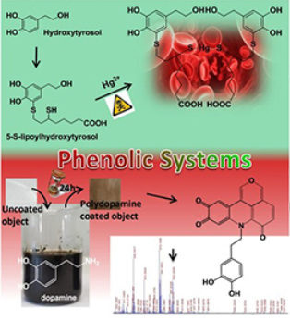
Title of the first completed research activity
Period: April 2024 - May 2025
Provide a concise overview of the first research activities you have undertaken. Try to keep each research activity on one slide.
If any papers have been written related to these activities, include them below.
Y. Yorozu, M. Hirano, K. Oka, and Y. Tagawa, “Electron spectroscopy studies on magneto-optical media and plastic substrate interface,” IEEE Transl. J. Japan, vol. 2, pp. 740–741, August 1987 [Digest 9th Annual Conf. Magnetics Japan, p. 301, 1982].
J. Yamato, (2022, June). Recognizing human action in time-sequential images using hidden Markov model. In CVPR. (accepted and to appear)

Slide 4
Title of the second completed research activity
Period: April 2024 - May 2025
You can include as many additional slides as needed to cover your main research activities.
Y. Yorozu, M. Hirano, K. Oka, and Y. Tagawa, “Electron spectroscopy studies on magneto-optical media and plastic substrate interface,” IEEE Transl. J. Japan, vol. 2, pp. 740–741, August 1987 [Digest 9th Annual Conf. Magnetics Japan, p. 301, 1982].
J. Yamato, (2022, June). Recognizing human action in time-sequential images using hidden Markov model. In CVPR. (accepted and to appear)

Slide 5
List of the publications
Insert the list of papers written during the Ph.D. program. If the paper is still not published indicate its status (e.g., submitted, under review, under 2nd review round, accepted to appear, etc.).
International Journal Articles
[j1] A. Einstein, "On the movement of small particles suspended in stationary liquids required by the molecular kinetic theory of heat." Ann. d. Phys. (under preparation)
[j2] G. Eason, B. Noble, and I. N. Sneddon, “On certain integrals of Lipschitz-Hankel type involving products of Bessel functions,” Phil. Trans. Roy. Soc. London, (submitted)
International Conference Proceedings
[c1] Y. Yorozu, M. Hirano, K. Oka, and Y. Tagawa, “Electron spectroscopy studies on magneto-optical media and plastic substrate interface,” IEEE Transl. J. Japan, vol. 2, pp. 740–741, August 1987 [Digest 9th Annual Conf. Magnetics Japan, p. 301, 1982]. (published)
[c2] J. Yamato, (2022, June). Recognizing human action in time-sequential images using hidden Markov model. In CVPR. (accepted and to appear)

Slide 6
Planned research activities
Provide a concise overview of the research activities you have planned to carry out in the future. Try to keep all planned research activities on one slide.
Title of the first planned research activity
Provide brief details of the research activity, including the duration, collaborations, and international activities or company involvement.
Title of the second planned research activity

